Slide 1

The Smell of Polymers: Prediction of Molecular Odor Characteristics by Deep Learning Models
Phase 3 Presentation
25th January 2024
Group 14
Christos Koromilas
Stephan Possen
Mireia Fortuño Ledesma
Lázár Dávid Barta
Mathias Verschueren
Notes:
Lazar
Present the project and the people!

Slide 2
Plan of the presentation
Introduction, Goal, and Research Questions
Background
Implementation
Data
Feature Extraction & Data Preparation
One-Class Classification (Autoencoders)
Multi-Label Models (Binary Relevance, NN, Optimized NN, Graph NN)
High-Level Data Fusion
Evaluation Metrics
Results & Discussion
Label Handling
Conclusions
Notes:
Lazar

Slide 3
1. Introduction
Notes:
Stephan

Slide 4
Introduction
Task: predict the smell(s) of polymers
Reason: Envalior is specialized in Engineering Materials
Our focus is on consumer goods
Why? “Leachables” can affect the smell/taste of consumables
EU regulations [1] require polymer testing BUT, can be long and expensive
A way to automate this process is in everyone’s interest
Notes:
Stephan
Our task for this project is to predict the smell of polymers
To explain to you why this is necessary, let’s talk a bit about what Envalior does why this would be useful
Envalior is a company that is specialized in designing and developing solutions that involve Engineering Materials
This involves different areas such as medical equipment, electronics and construction, but also consumer goods which is the focus for this project
Why consumer goods? Let’s say you bought plastic tupperware to store your food. Depending on the polymers used for this product, it can have a certain smell. This doesn’t have to be a problem immediately but there is something called “leachables”. Leachables are molecules that travel from the product into the consumable and when that happens, there is a chance that it affects the smell and/or taste of the consumable. This could lead to discomfort of the individual which is obviously unwanted.
Since there are also strict EU regulations on the presence of leachables, Envalior is required to test polymers on their smell and intensity before they can be used in production.
The problem is that these tests are done by a professional panel of people which can take a lot of time and cost a lot of money.
Therefore it is in everyone's best interest to find a way where this process of testing polymers for their smell can be automated.

Slide 5
Goal
Provide Machine Learning model(s) that can predict the presence of odor and identify which odors are present in leachable molecules identified in extracts.
Allow Envalior to minimize analytics and tests
Contribute to key challenge of mapping molecular structure to odor perception, since a clear mapping from molecular structure to odor description is still an open issue [2].
Notes:
Stephan

Slide 6
Research Question
Does a Deep Learning model accurately distinguish odorant from non-odorant molecules?
How effectively can a Deep Learning model assign correct odors to molecules?
How can Data Fusion improve the performance of predictive models?
Notes:
Stephan

Slide 7
2. Background
Notes:
Mathias

Slide 8
Background - Feature Extraction
RDKit Library [3] |  | MolGraph Library [4]
Cheminformatic toolkit Uses SMILES notation |  | Allows Graph representation of molecules
Molecular Fingerprints [5] | Molecular Descriptors [6] | Graph NN [7]
Binary encoding on substructures Indication or absence of substructures in the molecule | Fundamental insights into the chemical properties of the molecules | Nodes represent atoms, encompassing atomic features Edges represent bonds, detailing the bond features between atoms
Notes:
Mathias
A very important part of our project is the extraction of the features from the molecules, in order to make the molecules machine readable. We will use the features to fit the molecules into our prediction systems and to predict on them. There already exists a certain amount of work done That I will present you now.
The first tool is RDKit, that is a free open source cheminformatic toolkit. It uses the SMILES (Simplified Molecular Input Line Entry System) notation, is available in Python and for example allows to find similarities between molecules. This tool will be very useful for us for the feature extraction.

Slide 9
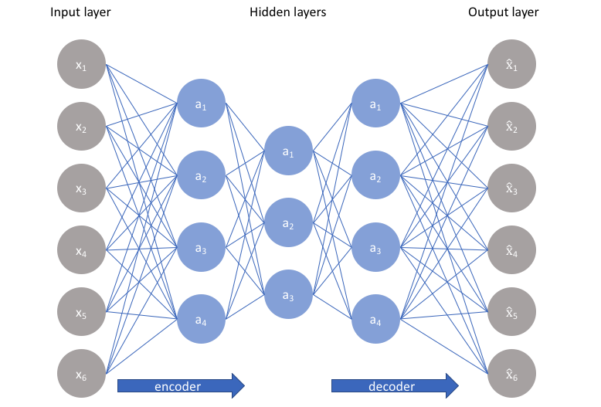
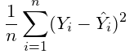
Background - One-Class Classification
One-Class Classification using Autoencoders
Autoencoders
Learning to reconstruct
Captures complex data nuances
Handles imbalance datasets
One-Class with Autoencoders
reconstruction error > threshold => anomaly
MSE as reconstruction error
https://www.jeremyjordan.me/autoencoders/
Notes:
Mathias
when one class classification? # 4300~ normal class, 57 anomalies
why autoencoders?
Autoencoders
learning to reconstruct the features
using the reconstruction error
higher reconstruction error than a threshold => anomalies)
Captures complex data nuances
Handles imbalanced datasets well

Slide 10
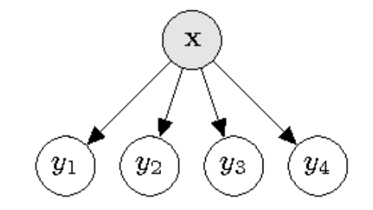
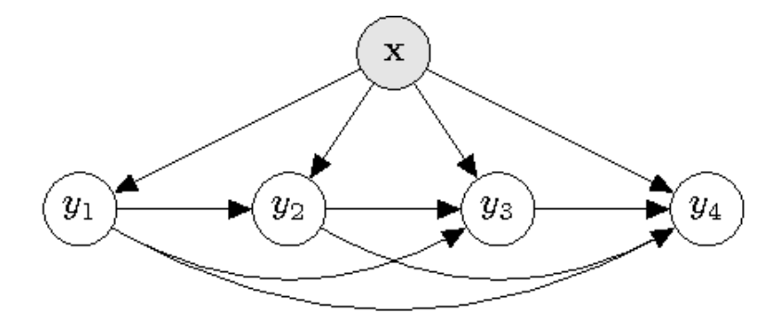
Background - Multi-Label Classification
Binary Relevance and Classifier Chains [8]
Multiple Single-Label Classification Model
Consider correlation of labels or not
Allows for inspection feature importance
Binary Relevance
Classifier Chains
Notes:
Mathias

Slide 11
Background - Multi-Label Classification
Neural Networks [9]
Multiple heads for odor descriptors
Any features in vector form
Black Box
Notes:
Mathias

Slide 12
Background - Multi-Label Classification
End-to-End GNN [7]
Graph based representation of molecules
Features extracted by model
Allows for creating multi-dimensional Odor map ⇒ Obtain predictors by projection
Human-expert level of performance
Notes:
Mathias

Slide 13
Background - Multi-Label Classification
Other Models [10]
Gradient based
Support Vector Machine
k-Nearest neighbors
⇒ Struggle with similar molecules having different smells
Notes:
Mathias

Slide 14
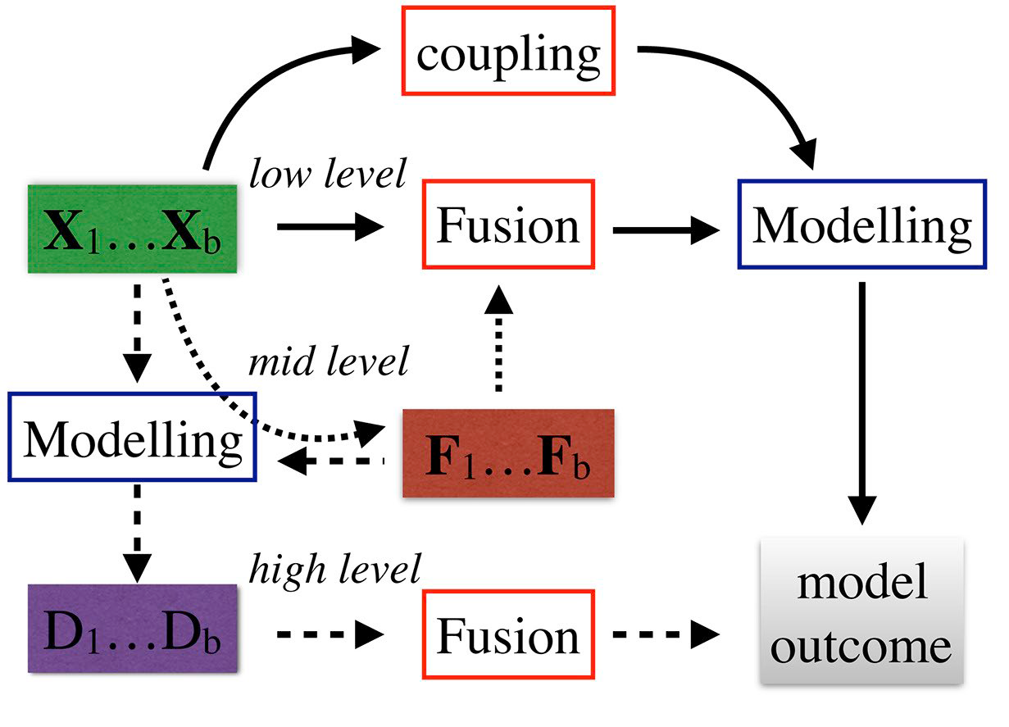
Background - Data Fusion
Data Fusion [11]
Low-Level: raw data from different sources is combined before any processing occurs
Mid-Level: features extracted from raw data are combined, data already preprocessed
High-Level: merging the outcomes of several models (different kinds of data) into a final decision
https://doi.org/10.1016/B978-0-444-63984-4.00001-6
Notes:
Mireia
In our project we choosed to use Data fusion.
Data Fusion allows us to integrate multiple data sources, potentially providing a more comprehensive view of the data patterns that are crucial for predicting odors.
There are generally three levels of Data Fusion:
Low Level, where data is combined at the sensory level;
Mid Level, involving the integration of features;
and High Level, where decisions from multiple classifiers are fused.

Slide 15
Background - Data Fusion
High-Level Fusion - Decision Fusion [12]
Majority Voting: Each classifier makes a vote. All classifiers have equal importance. Final decision = highest number of votes.
Bayesian Consensus: Updates the probability estimates of the outcomes based on Bayes’ theorem. Each classifier contributes to the final decision based on its performance and the confidence in its predictions.
Weighted Voting: Each classifier is assigned a weight based on its importance/reliability. The final decision is made based on the weighted sum of the votes from each classifier.
Notes:
Mireia

Slide 16
3. Implementation
Notes:
Mireia

Slide 17
Implementation - Approach
Task 1: Predict if molecules have an odor or not
Task 2: Predict what odors a molecule has
TASK 1 MODELLING
One-Class Classification
DATA FUSION
DATA PREPARATION & FEATURE EXTRACTION
DATA
TASK 2 MODELLING
EVALUATE
Multi-Label Classification
DATA FUSION
Notes:
Mireia

Slide 18
Implementation - Data
Dataset used in a challenge: AICrowd: Learning To Smell [13]
4316 SMILES and SENTENCES
109 scents
2772 combinations
57 odorless
Imbalanced data
SMILES | SENTENCE
C/C=C/C(=O)C1CCC(C=C1C)(C)C | fruity, rose
COC(=O)OC | fresh, ethereal, fruity
Cc1cc2c([nH]1)cccc2 | resinous, animalic
C1CCCCCCCC(=O)CCCCCCC1 | powdery, musk, animalic
CC(CC(=O)OC1CC2C(C1(C)CC2)(C)C)C | coniferous, camphor, fruity
Notes:
Christos

Slide 19
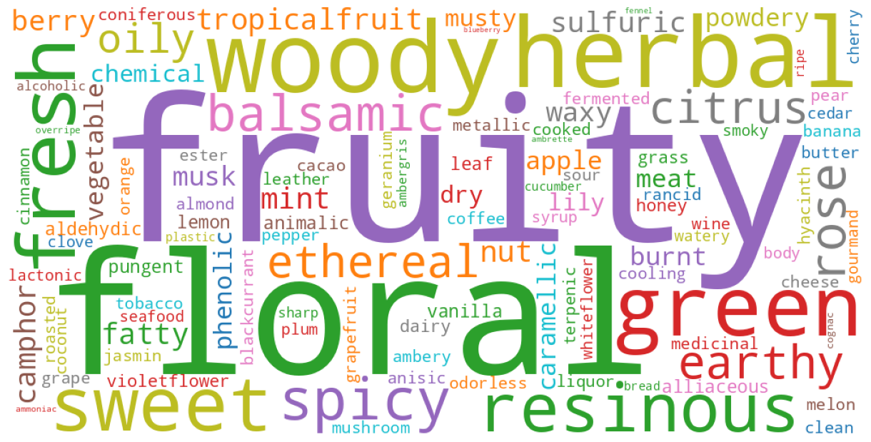
Implementation - Data Preparation
Prepare the SMILES and SENTENCES
Check for Duplicates
Check for NaN
Binarization
One hot encoding
Notes:
Christos

Slide 20
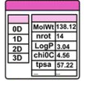
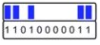
Implementation - Feature Extraction
Molecular Descriptors - using RDKit
Molecule's chemical and Physical properties
Scaled min/max 0 and 1
Removed the constant columns
Number of Features = 189
Circular Fingerprints (Morgan) - using RDKit
Atom pairs and Topological Torsions
Extracted in bit vectors
Number of Features = 2048-bits of 0s and 1s (sparse)
Molecular Graphs - using Molgraph
Molecules as graphs
Atoms (nodes)
Bonds (edges)
Notes:
Christos

Slide 21
Implementation - One-Class Classification
Binary Classification
SVC (SVM)
Deep Learning model for Binary classification
One-Class Classification (Anomaly Detection)
OC-SVM
Autoencoder
Notes:
Christos

Slide 22
Implementation - One-Class Classification
Autoencoders
3 Models: Descriptors, Fingerprints & Fused data
3 Optimized Models
DESCRIPTORS
DATA
FINGERPRINTS
DATA
FUSED (COMBINED)
DATA
Autoencoder
Autoencoder
Autoencoder
Optimized Autoencoder
Optimized Autoencoder
Optimized Autoencoder
Optimize Threshold
Optimize Threshold
Optimize Threshold
Notes:
Christos

Slide 23
Implementation - One-Class Classification
Autoencoders setup
Dense layers: 512 - 256 - 128 - 64 - 128 - 256 - 512
Activation functions: Relu
Batch Normalization between layers
Optimization of hyperparameters - using Keras-Tuner
Number of Layers: 2-10
Number of units on each: 32-2048
Learning rate of Optimizer
Notes:
Christos

Slide 24
Implementation - Multi-Label Classification
7 models in total
Output of the models: Top 3 smells with highest probability → Cardinality of the data = 3
Train 80% - Validation 10% - Test 10%
DESCRIPTORS
DATA
FINGERPRINTS
DATA
MOLECULAR STRUCTURE
DATA
Binary Relevance / Classifier Chains
Binary Relevance / Classifier Chains
Graph NN
Neural Network
Neural Network
Optimized NN
Optimized NN
Notes:
Mireia

Slide 25
Implementation - Multi-Label Classification
Binary Relevance & Classifier Chains [8]
2 models:
Descriptor Data Model
Fingerprints Data Model
12 configurations per Dataset
Binary Relevance
Classifier Chains
Base Single-Label Classifiers
Base Single-Label Classifiers
Random Forest
XGBoost
SVC
Random Forest
XGBoost
SVC
Class Weights
Notes:
Mireia

Slide 26
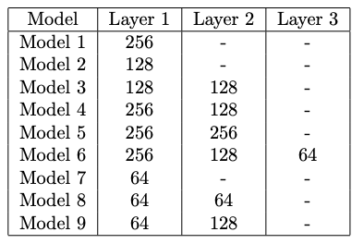
Implementation - Multi-Label Classification
NN [14]
Multiple experiments
9 models
1-3 hidden layers
sizes: 64, 128, 256
Input, output layers
Goal: minimize loss
20 epochs
Notes:
Lazar
For the neural networks, we have realized multiple experiments. During these experiments we have created 9 models with different numbers of hidden layers of different sizes. It is important to note, that the input layers were the descriptors or fingerprints and the output layers were the probabilities of each odor from the one hot encoding. During the training of our models, the goal of the training process was to minimize the loss. During our experiments we tried models with 1 to 3 hidden layers with different sizes. To determine the number of epochs we have done a first training with a high number of epochs (in our case: 50) and visualized the metrics for each training epochs on graphs to be able to find a suiting number of epochs. We found that 20 epochs are optimal and it still avoids overfitting.

Slide 27
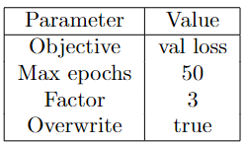
Implementation - Multi-Label Classification
Optimized NN
KerasTuner [15]
Optimize hyperparameters:
Number of units in dense layer
Activation function
Target is validation loss, not validation accuracy
Identical setup for descriptors and fingerprints
Notes:
Stephan

Slide 28
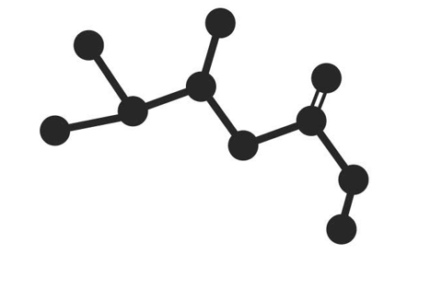
Implementation - Multi-Label Classification
Graph NN:
Graph embedding
{
Atoms
Bonds
[*]
Graph-Neural Network
*image: https://www.freevector.com/simple-flat-molecules-in-various-compostion-21215#
Notes:
Mathias

Slide 29
Implementation - Multi-Label Classification
Graph NN: MolGraph Library [4]
2 Graph Convolutional layers ⇒ Feature extraction
2 Dense layers ⇒ Feed forward
1 output layer sigmoid ⇒ Classification
Loss: Binary cross Entropy
Notes:
Mathias

Slide 30
Implementation - Multi-Label Classification
Graph NN: Problems
Limited data + high number of labels
⇒ overfitting
Possible solution:
⇒ Fine tune pre-trained model
Notes:
MAthias

Slide 31
Implementation - High-Level Data Fusion
Task 1
Weighted Voting [12]
Binary predictions per model
Tally exceeds half classifiers
Classifies as anomaly accordingly
Implements majority decision rule
Simple ensemble method
Notes:
Christos
We start with binary predictions from each of our models.
If the tally of 'anomalous' votes exceeds half of our classifiers, we classify the point as an anomaly.
It's a clear application of the majority decision rule.

Slide 32
Implementation - High-Level Data Fusion
Task 1
Bayesian Fusion [12]
Begins with 50/50 likelihood
Updates likelihood per classifier
Relies on confusion matrix stats
Final classification via probability
Adaptable, evidence-based approach
Notes:
Christos
For Bayesian Fusion, we implement an initial 50/50 likelihood for each classification outcome.
Each classifier's input updates this likelihood, using stats from confusion matrices to refine our estimates.
We conclude with the class that has the highest probability, embodying an adaptable, evidence-based approach.
It's a dynamic implementation, where each step is informed by the preceding one, ensuring a nuanced decision-making process.

Slide 33
Implementation - High-Level Data Fusion
Task 2
Majority Voting between the 7 Multi-Label Classification models
Model 1
Model 2
Model 3
Model 4
Model 5
Model 6
Model 7
Odor 1_1
Odor 1_2
Odor 1_3
Odor 2_1
Odor 2_2
Odor 2_3
Odor 3_1
Odor 3_2
Odor 3_3
Odor 4_1
Odor 4_2
Odor 4_3
Odor 5_1
Odor 5_2
Odor 5_3
Odor 6_1
Odor 6_2
Odor 6_3
3 points
Odor 7_1
Odor 7_2
Odor 7_3
2 points
1 point
Sum all the points and return the 3 Odors with highest scores
Notes:
Mireia

Slide 34
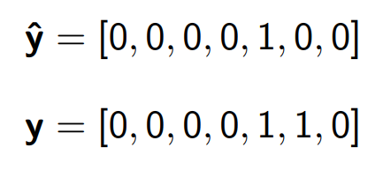
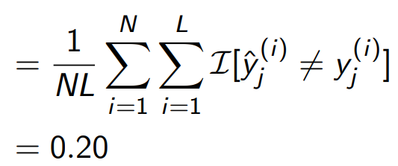
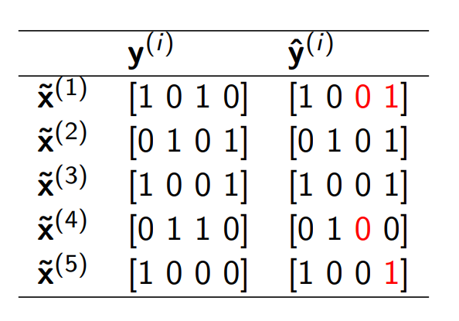
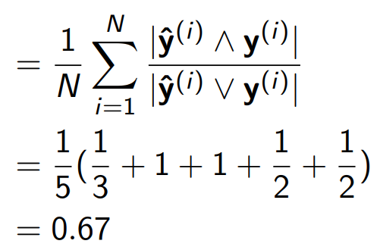
Implementation - Evaluation
Base:
Accuracy, recall, precision, F1-score
Problem: can be strict for multi-label
Multi-label specific:
Hamming loss
Jaccard score
[16]
[16]
Notes:
Stephan
Base evaluation metrics:
Accuracy, recall, precision, F1-score
Multi-label specific:
Hamming loss
Jaccard similarity
Size of intersection of true and predicted labels divided by size of union of true and predicted labels
Losses to use in NN:
Binary cross-entropy
How similar are 2 vectors where 1 is binary and the other is a vector with probabilities

Slide 35
Implementation - Evaluation
Losses in NN - for training
MSE not suited for Multi-Label Classification
It is suited for One-Class-Classification
Jaccard Loss, good for discrete classification
Measures the overlap between the received and the expected result
Binary cross-entropy for multi-label problems
Difference between the predicted probabilities and the actual binary outcomes, there is better
Focal Loss
Adjustment for unbalanced dataset
Notes:
Lazar
For the losses in the training for neural networks we experienced with many types of losses. First we experienced with the mean squared error, but it quickly turned out that it is not suited for multi label classification. It is more for one class classification problems.
Then we tried out the Jaccard Loss. It was already better, but didn’t suit our problem, since it measures the overlap between the received and the expected result. And our received results were probabilistic results. We will discuss later how we approached this situation.
Binary Cross-Entropy quantifies the difference between the predicted probabilities and the actual binary outcomes, penalizing predictions that diverge from the actual labels. The loss increases significantly as the predicted probability diverges from the actual label, thus encouraging the model to make predictions with higher certainty towards the true class labels.
Finally we used the Focal Loss that is a modified version of the cross-entropy loss designed to address class imbalance by focusing training on hard, misclassified examples. It introduces a modulating factor to the standard cross-entropy criterion, reducing the loss contribution from easy to classify examples, which prevents the overwhelming of the loss by the majority class. This adjustment encourages then the model to prioritize learning from the minority class and the more difficult cases, improving performance in imbalanced datasets. This was particularly useful, since we had to work with a particularly unbalanced dataset.

Slide 36
4. Results & Discussion
Notes:
Lazar

Slide 37
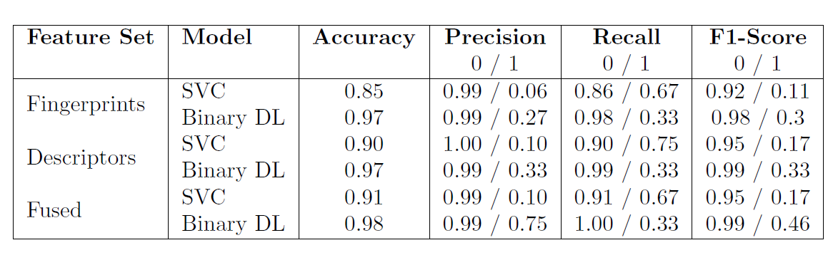
Results & Discussion - Task 1
Binary Classification (balanced weights)
Results looking good but we have imbalanced dataset.
Notes:
Christos

Slide 38
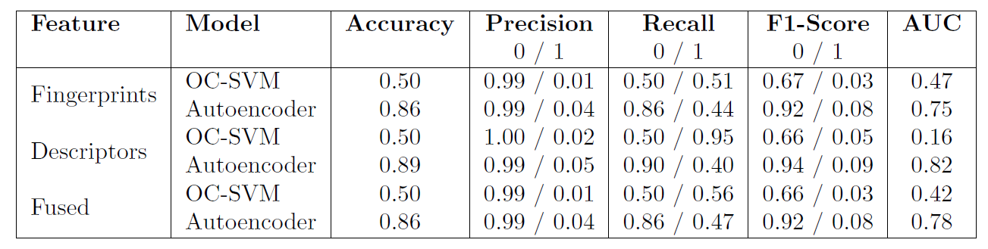
Results & Discussion - Task 1
One-Class Classification
Results looking good for Autoencoders!
Notes:
Christos

Slide 39
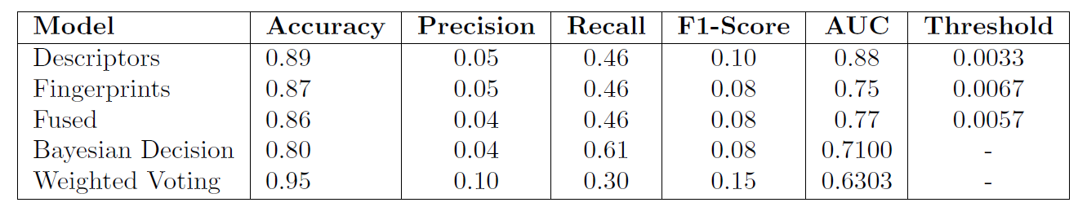
Results & Discussion - Task 1
Autoencoders
Notes:
Christos

Slide 40
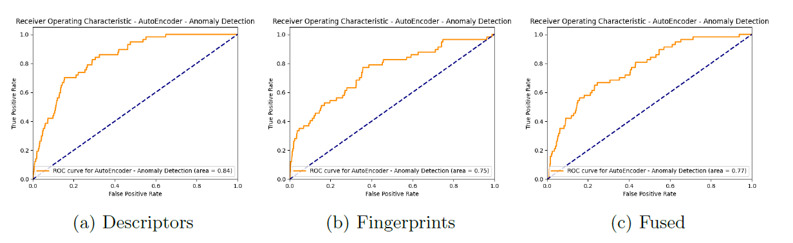
Results & Discussion - Task 1
Autoencoders
Notes:
Christos

Slide 41
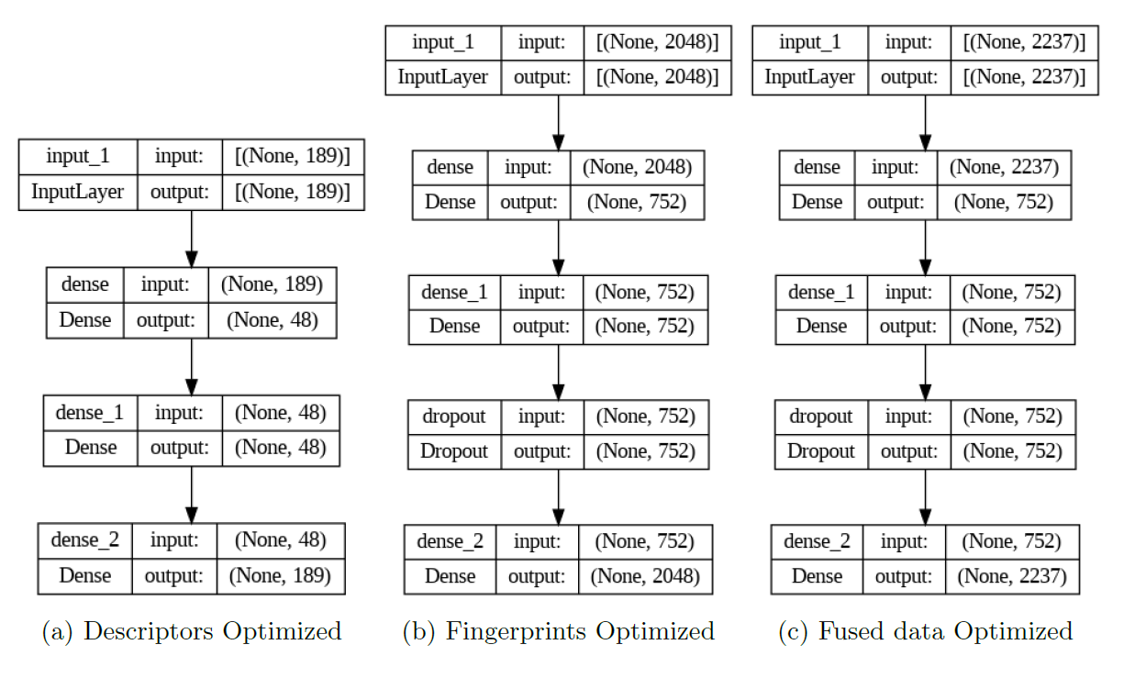
Results & Discussion - Task 1
Optimized Autoencoders
Notes:
Christos

Slide 42
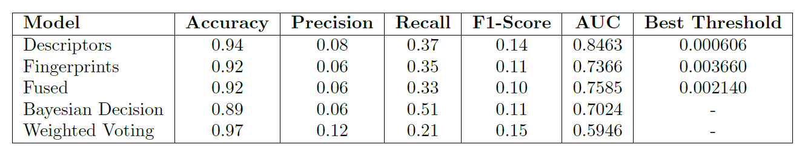
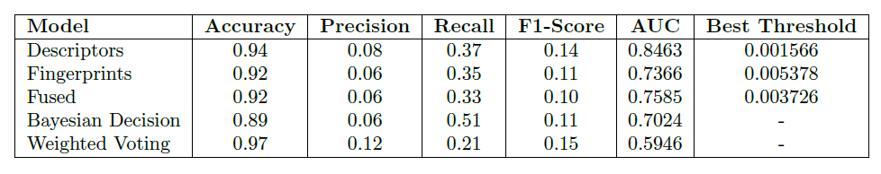
Results & Discussion - Task 1
Optimized Autoencoders
Notes:
Christos

Slide 43
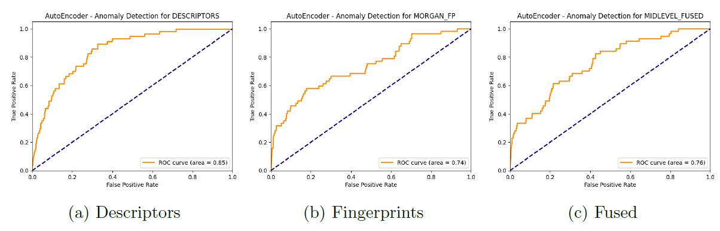
Results & Discussion - Task 1
Optimized Autoencoders
Notes:
Christos

Slide 44
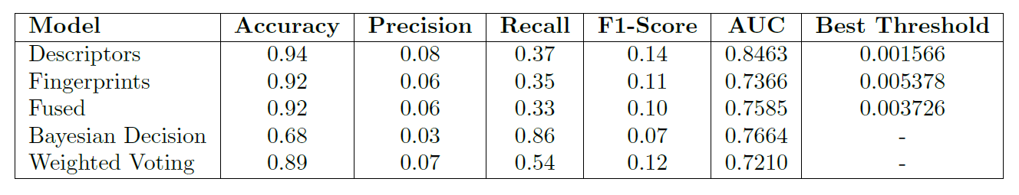
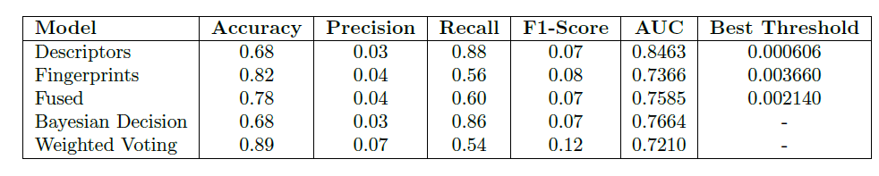
Results & Discussion - Task 1
Optimum Threshold
Notes:
Christos

Slide 45
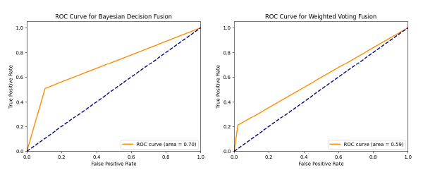
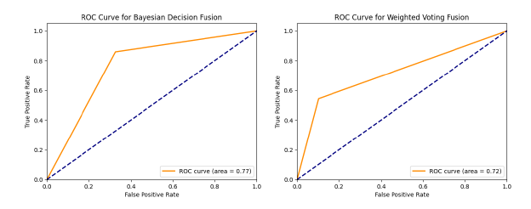
Results & Discussion - Task 1
High level for Optimized Threshold
After optimum threshold Before optimum threshold
Notes:
Christos

Slide 46
Results & Discussion - Task 2
Binary Relevance / Classifier Chains
Winning model for Descriptors and Fingerprints is the same:
Binary Relevance with XGBoost Base Classifier with Class Weights
Classifier Chain produce similar results, but more complex and higher training time
MODEL | Categorical Accuracy | Precision | Recall | F1-Score | Jaccard Score | Hamming Loss
BR + XGBoost + Class Weights (DESCRIPTORS) | 0.01 | 0.29 | 0.34 | 0.29 | 0.21 | 0.04
BR + XGBoost + Class Weights (FINGERPRINTS) | 0.01 | 0.30 | 0.33 | 0.29 | 0.20 | 0.04
Notes:
Mireia

Slide 47
Results & Discussion - Task 2
NN
Better results as phase 2
Less overfitting
Results still could be better
Training metrics: loss, recall, precision, categorical accuracy
Notes:
Lazar

Slide 48
Results & Discussion - Task 2
NN
Model 1
16/16 - 0s - loss: 0.0290 - recall: 0.1905 - precision: 0.4024 - categorical_accuracy: 0.1777
Model 2
16/16 - 0s - loss: 0.0255 - recall_1: 0.1464 - precision_1: 0.4180 - categorical_accuracy: 0.1488
Model 3
16/16 - 0s - loss: 0.0297 - recall_2: 0.1821 - precision_2: 0.3892 - categorical_accuracy: 0.1488
Model 4
16/16 - 0s - loss: 0.0305 - recall_3: 0.2080 - precision_3: 0.3987 - categorical_accuracy: 0.1508
Model 5
16/16 - 0s - loss: 0.0363 - recall_4: 0.1884 - precision_4: 0.3375 - categorical_accuracy: 0.1632
Model 6
16/16 - 0s - loss: 0.0304 - recall_5: 0.1793 - precision_5: 0.3963 - categorical_accuracy: 0.1570
Model 7
16/16 - 0s - loss: 0.0231 - recall_6: 0.1113 - precision_6: 0.4441 - categorical_accuracy: 0.1570
Model 8
16/16 - 0s - loss: 0.0240 - recall_7: 0.1225 - precision_7: 0.4310 - categorical_accuracy: 0.1570
Model 9
16/16 - 0s - loss: 0.0260 - recall_8: 0.1492 - precision_8: 0.4251 - categorical_accuracy: 0.1550
Could be better…
Notes:
Lazar
Not that good results, due to probabilistic results.. We will get back to that

Slide 49
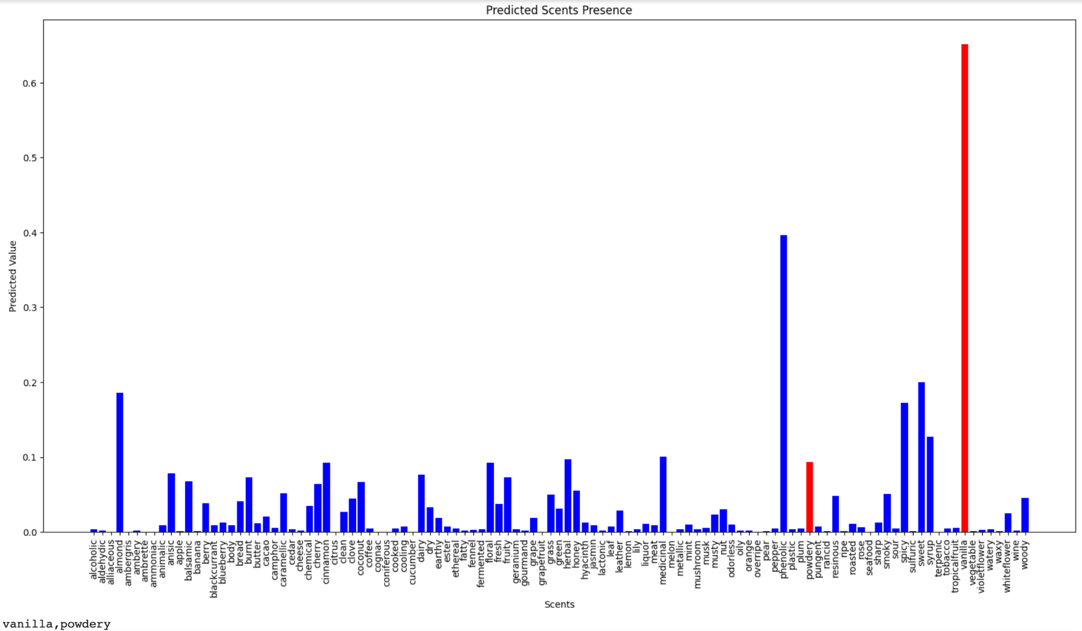
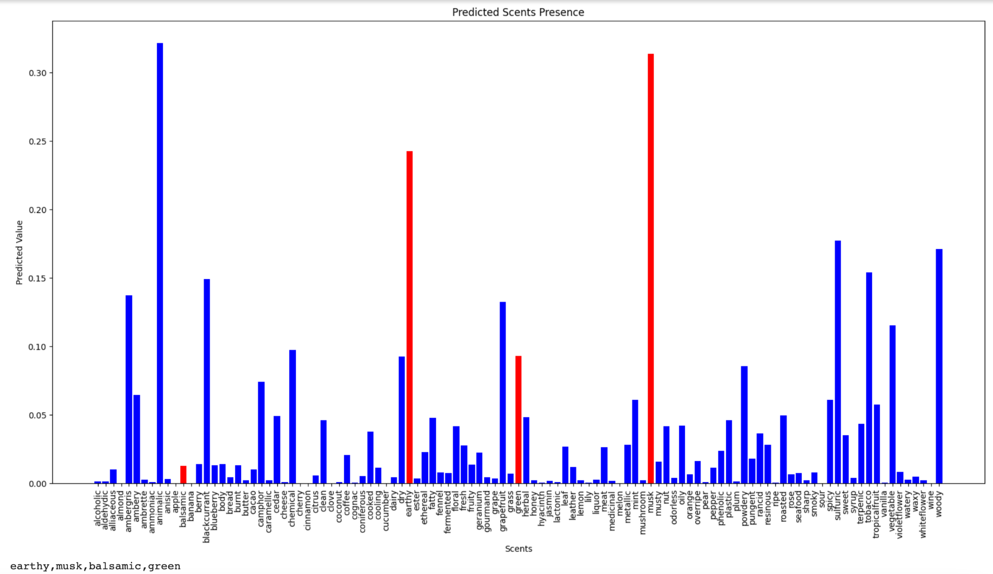
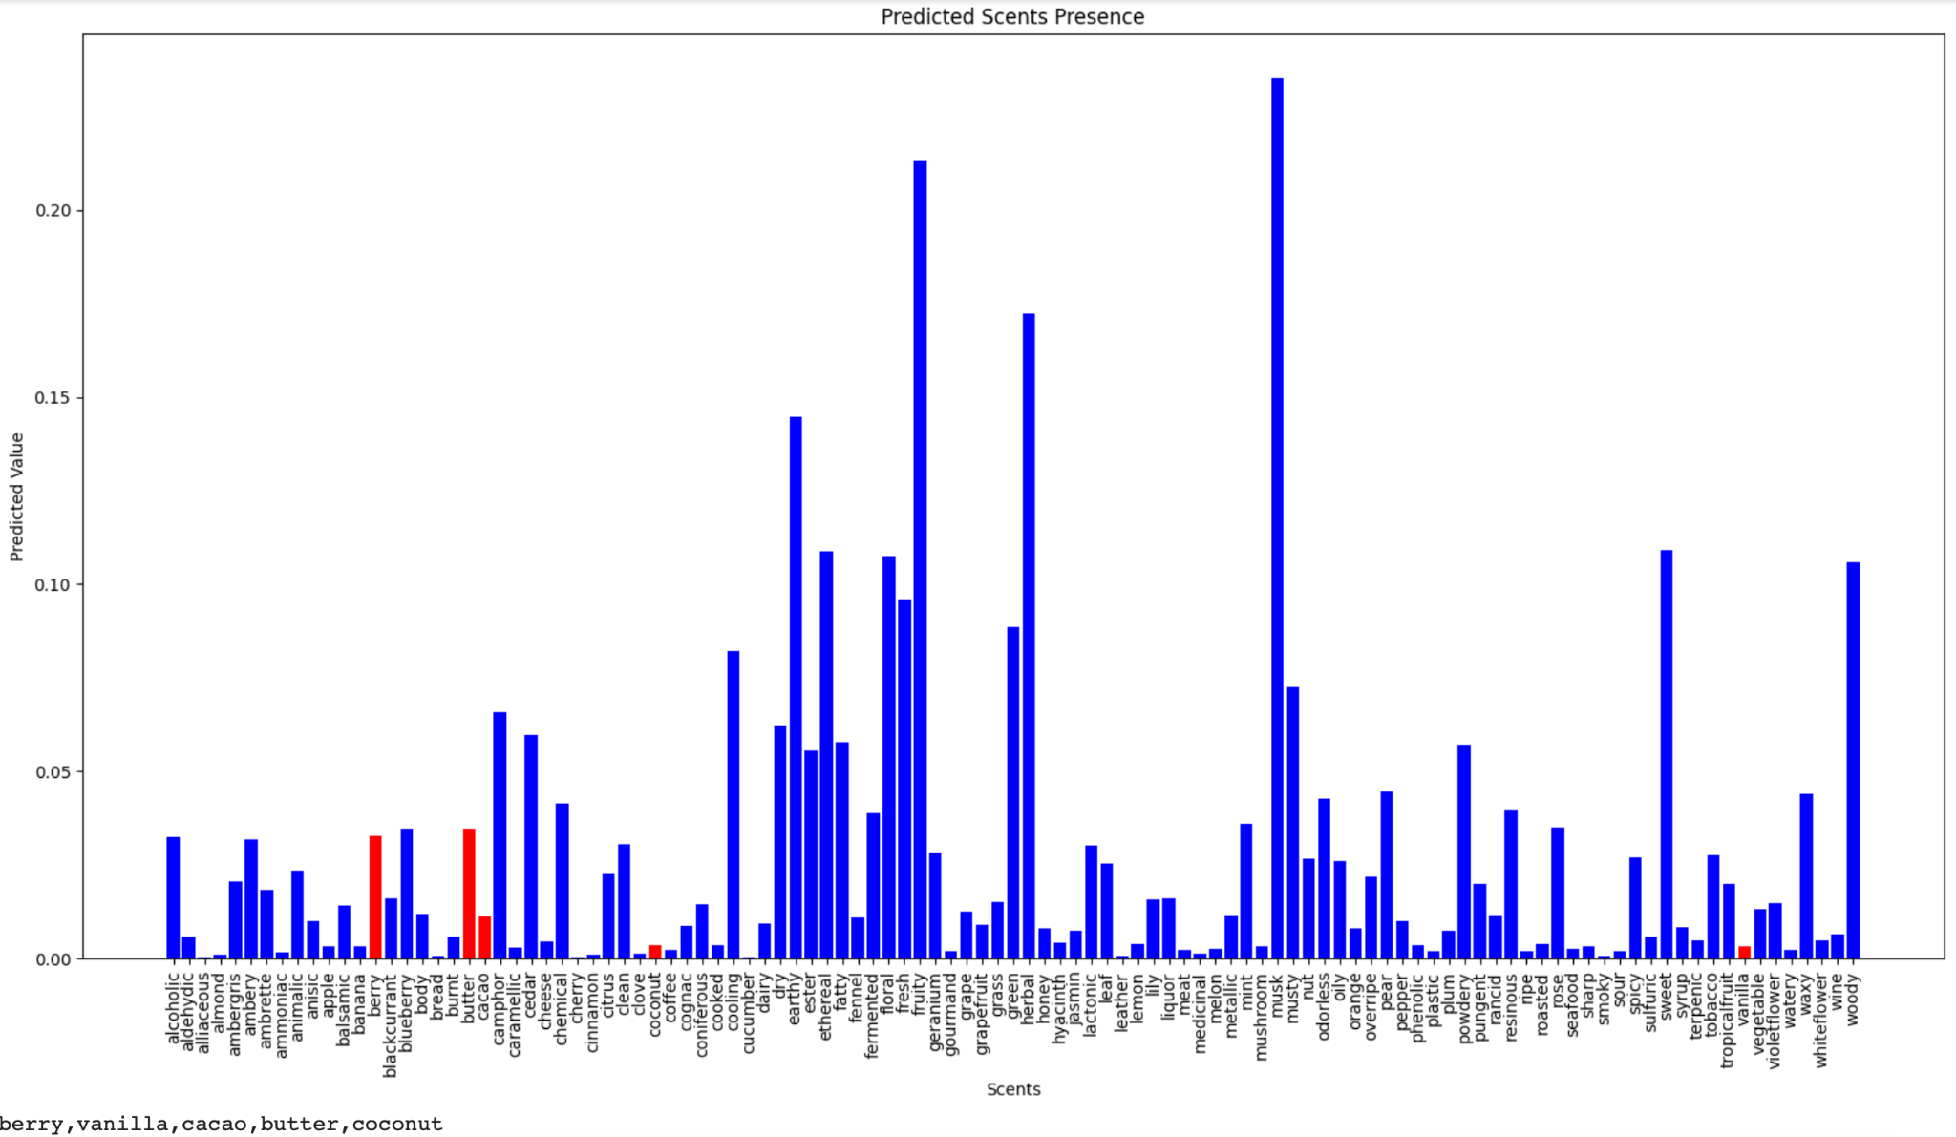
Results & Discussion - Task 2
NN
Threshold?
Notes:
Lazar
Could we put a threshold for these values, so we can discretize them?

Slide 50
Results & Discussion - Task 2
NN - problems
Suboptimal results
Probabilistic predictions
Difficulty to define a threshold
NN - solution
Top 3 predictions as result
Binary predictions
No need for threshold
Better results
Notes:
Lazar
Problems:
Looking at the previous metrics, we could see that some of them were lower than acceptable for a good neural network. As explained earlier, this is due to the model's probabilistic prediction mechanism. A considered approach of correcting the errors linked to the probabilistic approach of the NN model is setting a treshold. We considered implementing this approach, but finally it was aborted due to the differences between the confidence levels in different predictions. The initial idea was to set the treshold to 0.5. As visible on figure \ref{fig:nn_predictions}, for some predictions, the maximum probability for an odor to be present is below 0.5 even though this odor would be relevant for our prediction. In this case we could lower the treshold, but the it would take non relevant odors into consideration as well, when the average confidence level is high.
Solution:
A possible remediation is taking only the top 3 predictions, by their values and considering them as positives, and the rest as negatives. Then we can compare these 3 odors with the expected odors and we don’t need to define a treshold. Of course, this is a partial solution, because if there are 2 or 4 expected odors, it will still predict 3. Like this we could have a binary output and then obtain better results on the metrics

Slide 51
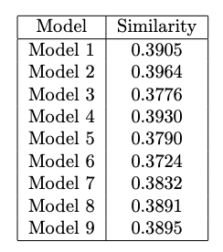
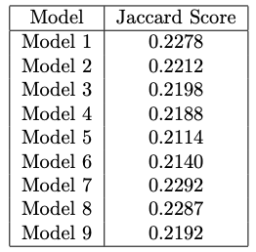
Results & Discussion - Task 2
NN - top 3 predictions
New custom metric for NN: Similarity
Important metric: Jaccard Score
Better results for other metrics
Accuracy
Precision
Recall
F1-score
Hamming Loss
Notes:
Lazar
With the new method of getting predictions, we could develop a new metric, that we called similarity metric.. This metric works in the following way : It counts the number of odors that match between the predicted and expected sets. Then the metric calculates the proportion of these matches relative to the number of actual odors, with a maximum consideration of three. By basing the proportion on up to three odors, this metric mitigates some of the inaccuracies inherent in a model that rigidly predicts three odors. This new metric offers a more nuanced assessment of the model's predictive accuracy in the context of our specific problem domain.
An important metric for our models is the Jaccard Score. It is very similar to our similarity metric. It takes the overlap between the top 3 odors and the expected odors. It gives lower values, because here there is counterbalancing of the limitation linked to the fixed number of predicted odors.
We also computed other metrics as welle such as Accuracy, Precision, Recall, F1-score and hamming loss.

Slide 52
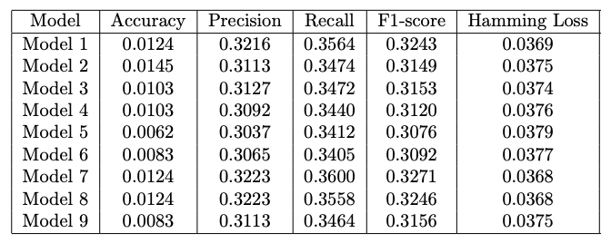
Results & Discussion - Task 2
NN - top 3 predictions
Notes:
Lazar
Our new approach significantly improved recall, reaching approximately 31%, by enabling the model to make binary predictions about odor presence, thus enhancing its discriminative capability. Despite this improvement, the need for higher-quality data is evident to further elevate performance.

Slide 53
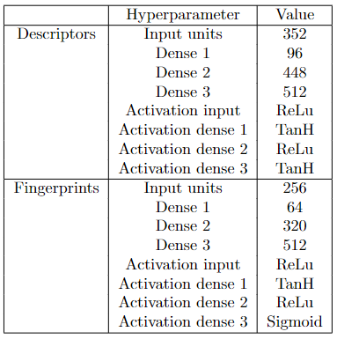
Results & Discussion - Task 2
Optimized NN
Slightly different hyperparameter sets
Less neurons for fingerprints
Possible explanation is that input vector of fingerprints is larger →
Use less neurons to reduce information, generalize more and prevent overfitting
Notes:
Stephan

Slide 54
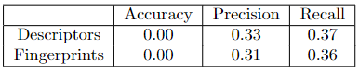
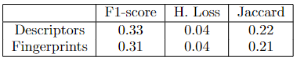
Results & Discussion - Task 2
Optimized NN
Jaccard Score similar to base models
No real improvement
It is possible that the low amount of imbalanced data does not allow for optimization
More in depth research possible but not in scope of this project
Notes:
Stephan
Second problem is that the search is done on validation data. Hyperparameters might be optimized for validation data but work less well on test data → doesn’t generalize well
Larger amount of data might help

Slide 55
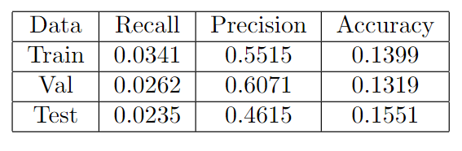
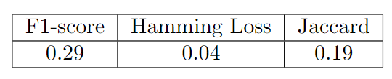
Results & Discussion - Task 2
Graph NN
Top 3
Notes:
Mathias

Slide 56
Results & Discussion - Task 2
Decision Fusion
MODEL | Categorical Accuracy | Precision | Recall | F1-Score | Jaccard Score | Hamming Loss | ORDER
BR (descriptors) | 0.01 | 0.29 | 0.34 | 0.29 | 0.21 | 0.04 | 4
BR (fingerprints) | 0.01 | 0.30 | 0.33 | 0.29 | 0.20 | 0.04 | 5
NN (descriptors) | 0.00 | 0.32 | 0.36 | 0.32 | 0.22 | 0.04 | 2
NN (fingerprints) | 0.01 | 0.29 | 0.32 | 0.28 | 0.19 | 0.04 | 7
OPT NN (descriptors) | 0.00 | 0.33 | 0.37 | 0.33 | 0.22 | 0.04 | 1
OPT NN (fingerprints) | 0.00 | 0.31 | 0.36 | 0.31 | 0.21 | 0.04 | 3
Graph NN | 0.00 | 0.29 | 0.33 | 0.29 | 0.19 | 0.04 | 6
DATA FUSION | 0.01 | 0.36 | 0.41 | 0.36 | 0.26 | 0.03
Would be on Top 10
Best Results of Competition: Jaccard Scores around 0.4-0.3
Jaccard Score is computed for the Top-5 sentences in comparison to the ground truth, and the best score across all 5 predictions is considered for the said molecule
Notes:
Mireia

Slide 57
5. Label Handling
Notes:
Mireia

Slide 58
Label Handling
OPTION 1 | OPTION 2 | OPTION 3 | OPTION 4
Paper [17] | Paper [7] | Papers [18] and [19] | Team Proposal
250 odor descriptors clustered into 20 categories using Bayesian Co-occurrence Embedding (BCE) | 55 odor descriptors (ODs) | 20 odor descriptors (not fully matching with ODs in our data) | Use Top 30 most ocurrant ODs & filter data with only these
Categories are to broad (plastic & earthy in same Category ) → Ambiguous & hard to interpret results | Classify remaining 54 ODs into one of the 55 → Human Error & Biases Keep only records with these 55 ODs → Maintain 84% of data | Have to match 89 ODS → Too many possible errors & biases | Keep 90% original data Other 79 ODs have almost no representation
Notes:
Mireia

Slide 59
6. Conclusion
Notes:
Lazar

Slide 60
Conclusions
Q1: Deep Learning models can distinguish odorant from non-odorant molecules
Q2: Several Machine Learning and Deep Learning models can assign correct odor descriptors to molecules
Q3: Different models perform better / worse with respects to different metrics, Data Fusion improves the performance of the models for both tasks
Notes:
Lazar
Regarding the Research Questions initially stated, the results of this project demonstrate that a Deep Learning model can in fact distinguish odorant from non-odorant molecules, although not to the fullest extent. Additionally, we have seen that several Machine Learning and Deep Learning models can assign correct odor descriptors to molecules to some degree, but the limited available data in combination with the high amount of labels complicated both tasks.
Finally, the results indicated that different models perform better / worse with respects to different metrics and that Data Fusion in particular High-Level Data Fusion, improves the performance of the models for both tasks.

Slide 61
Conclusions
Good experience
Results: meh
Goals achieved
Learning opportunity
Good topic
Notes:
Lazar
In summary, we're really happy with what we've managed to do in this project. Even though we didn't get super accurate predictions about the smells, we achieved our main goals like trying out and learning about different ways to make predictions with computers.This was the first big project for us in our master studies, and it taught us a lot. It was the first time for many of us to try out artificial intelligence models by ourselves, which was very enriching and taught us a many new things. We ran into some problems and didn't get everything right the first time, but figuring out those issues taught us a lot that we'll use in the future. Choosing this topic was a great choice. It let us dive deep into how to make predictions using computers, giving us a lot of practice and learning. We're finishing this project with a lot of new knowledge and skills, and we feel very happy about it.

Slide 62
Thank you for your attention!
Group 14
Christos Koromilas
Stephan Possen
Mireia Fortuño Ledesma
Lázár Dávid Barta
Mathias Verschueren
Notes:
Lazar

Slide 63
References
[1] https://food.ec.europa.eu/safety/chemical-safety/food-contact-materials/legislation_en#:~:text=The%20principles%20set%20out%20in,odour%20in%20an%20unacceptable%20way
[2] Andreas Keller et al. “Predicting human olfactory perception from chemical features of odor molecules”. In: Science 355.6327 (2017), pp. 820–826.
[3] RDKit https://rdkit.org/
[4] Alexander Kensert, Gert Desmet, and Deirdre Cabooter. “MolGraph: a Python package for the implementation of small molecular graphs and graph neural networks with TensorFlow and Keras”. In: arXiv preprint arXiv:2208.09944 (2022).
[5] Molecular fingerprints and similarity searching. https://openbabel.org/docs/dev/Fingerprints/intro.html#:~:text=Molecular%20fingerprints%20are%20a%20way,particular%20substructures%20in%20the%20molecule.
[6] Greg Landrum. url: https://greglandrum.github.io/rdkit-blog/posts/2022-12-23-descriptor-tutorial.html
[7] Brian K. Lee et al. ,A principal odor map unifies diverse tasks in olfactory perception. Science 381, 999-1006 (2023). DOI:10.1126/science.ade4401

Slide 64
References
[8] Saini, K., Ramanathan, V. Predicting odor from molecular structure: a multi-label classification approach. Sci Rep 12, 13863 (2022). https://doi.org/10.1038/s41598-022-18086-y
[9] Liang Shang et al. “Artificial intelligence based gas chromatography-olfactometry for sensory evaluation of key compounds
in food ingredients”. In: bioRxiv (2022). doi: https://doi.org/10.1101/2022.04.20.488977.full.pdf. url: https://www.biorxiv.org/content/10.1101/2022.04.20.488977v2
[10] Rinu Chacko et al. “Data based predictive models for odor perception”. en. In: Sci. Rep. 10.1 (Oct. 2020), p. 17136
[11] Marina Cocchi; Chapter 1 - Introduction: Ways and Means to Deal With Data From Multiple Sources https://www.sciencedirect.com/science/article/abs/pii/B9780444639844000016
[12] D. Ballabio, R. Todeschini, and V. Consonni. “Chapter 5 - Recent Advances in High-Level Fusion Methods to Classify Multiple Analytical Chemical Data”. In: Data Fusion Methodology and Applications. Ed. by Marina Cocchi. Vol. 31. Data Handling in Science and Technology. Elsevier, 2019, pp. 129–155. doi: https://doi.org/10.1016/B978-0-444-63984-4.00005-3. url: https://www.sciencedirect.com/science/article/pii/B9780444639844000053
[13] Learning to Smell AIcrow: https://www.aicrowd.com/challenges/learning-to-smell

Slide 65
References
[14] TensorFlow: https://www.tensorflow.org/guide/keras
[15] Tom O’Malley et al. KerasTuner. https://github.com/keras-team/keras-tuner
[16] https://users.ics.aalto.fi/jesse/talks/Multilabel-Part01.pdf
[17] Shang, L., Tang, F., Liu, C., Chen, B., Liu, L., & Hayashi, K. (2022). Machine-Learning-Based Olfactometry: an auxiliary system for human assessors in olfactory measurement. bioRxiv (Cold Spring Harbor Laboratory). https://doi.org/10.1101/2022.04.20.488973
[18] Keller, A., Gerkin, R. C., Guan, Y., Dhurandhar, A., Turu, G., Szalai, B., Mainland, J. D., Ihara, Y., Yu, C. W., Wolfinger, R., Vens, C., Schietgat, L., De Grave, K., Norel, R., Stolovitzky, G., Cecchi, G. A., Vosshall, L. B., & Meyer, P. (2017). Predicting human olfactory perception from chemical features of odor molecules. Science, 355(6327), 820–826. https://doi.org/10.1126/science.aal2014
[19] Chacko, R., Jain, D., Patwardhan, M., Puri, A., Karande, S., & Rai, B. (2020). Data based predictive models for odor perception. Scientific Reports, 10(1). https://doi.org/10.1038/s41598-020-73978-1

